Slide 1


Banking Chatbot By: AMINE Ahmiri Complete ProJECT Under the guidance of Dr. M. Aabdollah

Slide 3
1.Artificial chatbot system
Natural language processing is a field of cognitive science derived from artificial intelligence and linguistics. It involves the generation and comprehension of natural human language by a computer or by artificial agents.
Techniques and technologies will be developed in this project to solve some problems found in modern desktop assistants. Personal digital assistants perform a myriad of services including but no limited to the organization and storage of data as well as the intelligent retrieval of subsets of information. These assistants range from personable to more useful (ie google search).
Intelligent Chatbot is a project that explores what we can accomplish with Artificial Intelligence. It is a chatbot that receives questions from the user then translates to machine language to provide appropriate answers. It does this by convering and English sentence into a machine friendly query to answer the question and returning the answer in a natural language sentence.

Slide 4
The project
2.THE PROJECT
Purpose: is to showcase the power of ChatBots and how they can be an alternative to using an application or a website. The ChatBot is easy to use and gives responses in a timely manner. It makes user interaction easy and fast to ensure the user’s time is not wasted and they get a response to their question without any difficulties or misunderstandings from the ChatBot.
Goal: to build a proof of concept system which we can use to deliver better results. This will be accomplished by solving some problems found in current information retrieval and personal assistant systems: syntactic indifference and word sense confusion.

Slide 5
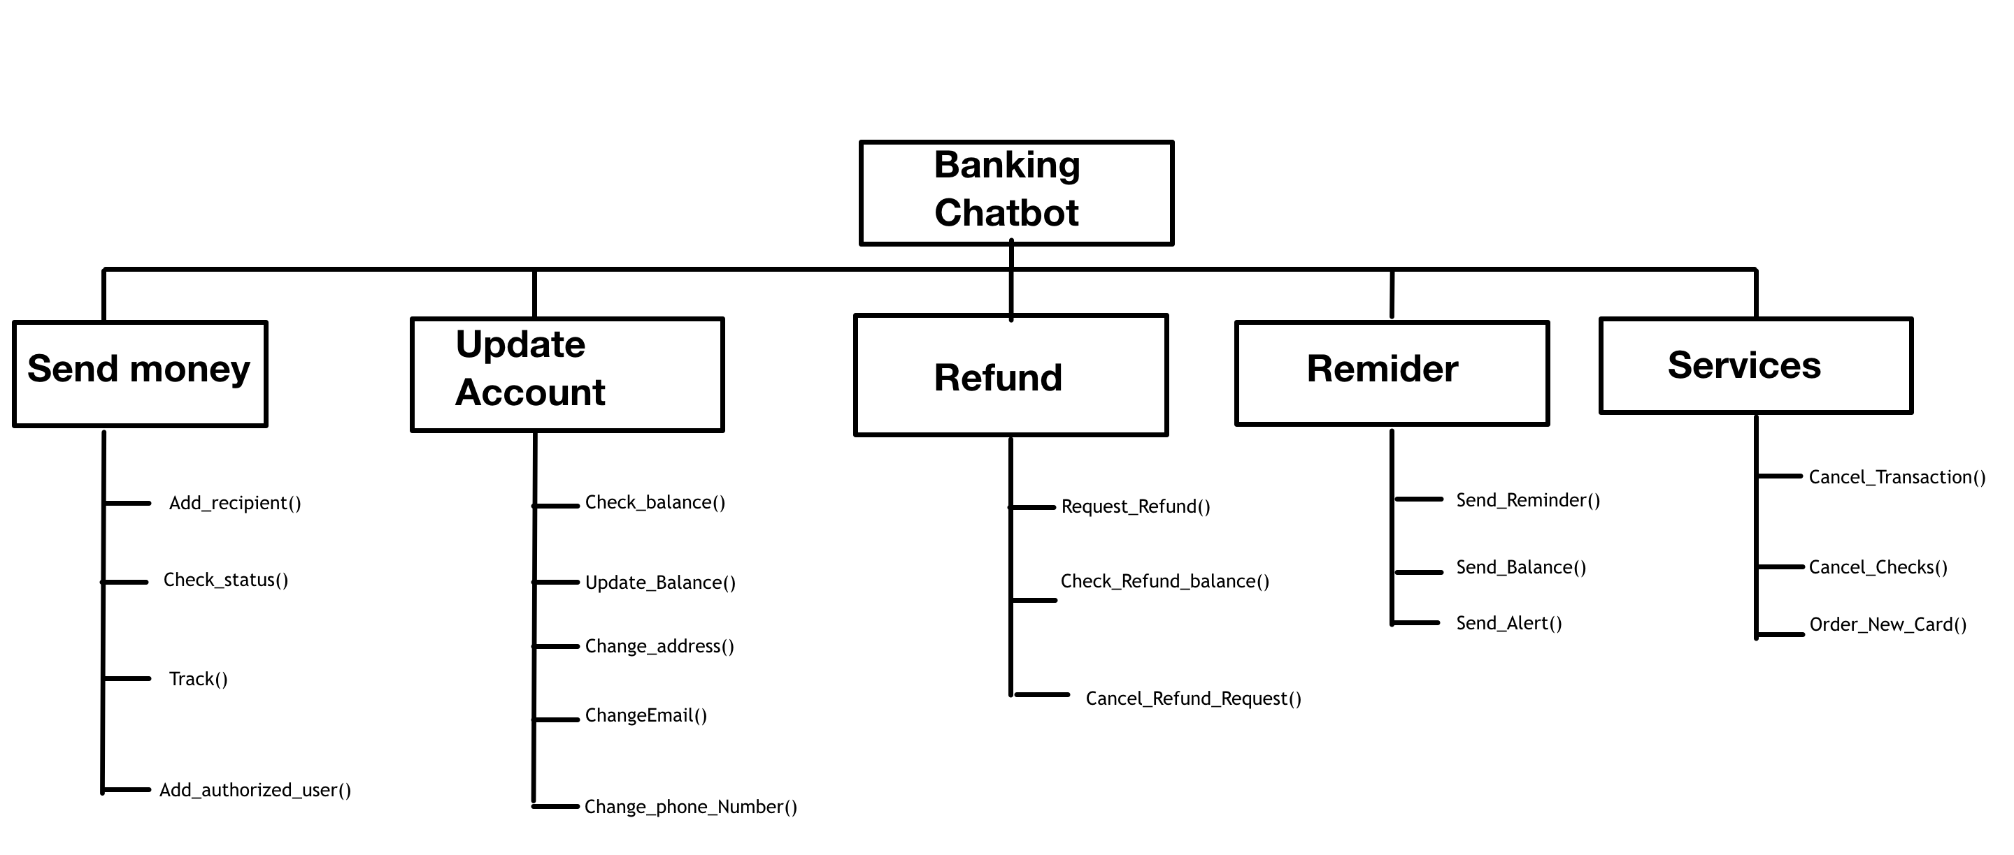
3.Block diagram

Slide 6
Artificial intelligence chatbot:
A block diagram is a diagram of a system in which the principle parts of function are represented by blocks connected by lines that show the relationship of the blocks. It may also show the how the system operates and its inputs and out puts at various stages. Bots combine the best form because they are rule-based and intellectually independent. Chatbots understand free language but also have a predefined flow to make sure they solve the user’s problem. They can remember the context of the conversation and the user’s preferences. These ChatBots can jump from one point of the conversation to another scenario when needed and address random user requests at any moment.

Slide 7
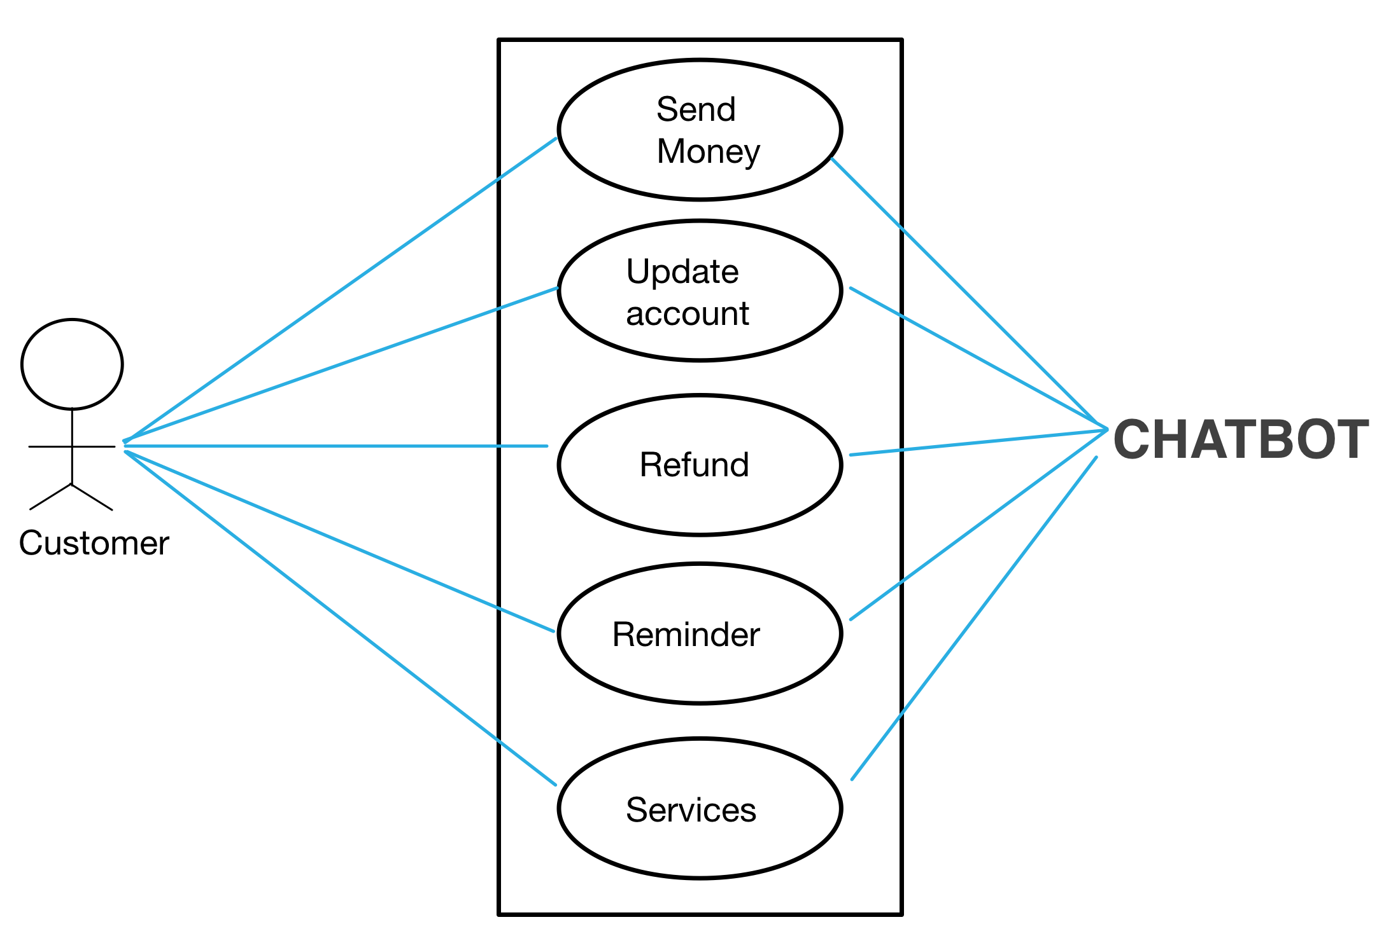
4.Case Diagram

Slide 8
5.Interfaces classes
Send money | type | length
Add_recipient() | CHAR | 5
Check_status() | string | xxxxxxxxx
Track() | string | xxxxxxxxx
Add_authorized_user() | string | xxxxxxxxx
UPDATE ACCOUNT
Check_Balance() | foat | 10

Slide 9
Interfaces classes
Update_Balance() | Float | 10
Change_address() | string | xxxxxxxxxxxxxx
ChangeEmail() | string | xxxxxxxxxxxxxx
Change_phone_Number() | string | xxxxxxxxxxxxxxx
REFUND
Request_Refund() | CHAR | 5
Check_Refund_balance() | string | xxxxxxxxx

Slide 10
Interfaces classes
Cancel_Refund_Request() | Bool | True/False
REMINDER
Send_Reminder() | string | xxxxxxxxx
Send_Balance() Send_Alert() | Bool string | 10 xxxxxxxxx
SERVICES
Cance_Transaction() | string | xxxxxxxxx
Cancel_Checks() Order_New_Card() | CHAR CHAR | 5 5

Slide 11
6.Functional requirements
Requirements that directly effect the capabilities of the bot,
both comprehension of the input
Generation of an answer in natural language
Accuracy of the information delivered

Slide 12
Send money:
1.Add_recipient(): the user should be able to add money to his account when wanting to send money from his account
2.Check_status(): check the status of a transaction when a user sends money
3.Track(): client should be able to track any transaction.
4.Add_authorized_user()

Slide 13
Update account:
5.Check_balance() : function to check the balance of the account.
6.Update_Balance(): function to update the balance of the account after any transacion.
7.Change_address(): function will allow customer to change primary address associated with account
8.ChangeEmail(): function will allow customer to change email associated with account
9.Change_phone_Number(): function allows customer to check and change phone number associated with the account

Slide 14
Refund:
10.Request_Refund(): customer can request refund of any transaction especially if transaction is suspicious
11.Check_Refund_balance(): function allows customer to check refund balance after refund has been processed.
12.Cancel_Refund_Request() : Function will allow refund request to cancel a refund request

Slide 15
Reminder:
13.Send_Reminder(): function will send reminder to account owner
14.Send_Balance(): function will send account balance to owner after each transaction
15.Send_Alert(): function will send alert to account owner after each transaction and after any suspicious activity

Slide 16
Services:
16.Cancel_Transaction(): function will allow owner to cancel transations and will be used to block cards
17.Cancel_Checks(): function can be used to cancel or void checks
18.Order_New_Card(): function allows customer to order new card when theirs is lost or has been blocked.

Slide 17
7.Non functional requirements
Reliability: may go down once a month be back within 5 min
Response time: 5 second
Security: Administrative system must be protected from unauthorized access so that clients have peace of mind knowing their information is secure. Security must include conversations between chatbot and client
The system is secured by :
Username
Password
Last 4 digit of social security number
Size: chatbot should be able to answer 1 million questions. More than 1 million questions will require a second chatbot
User interface: an easy to maintain and use interface across all functionality and all users, interface should be compatible with all commonly used browsers, {internet explorer, fire fox, google Chrome}
Scalability: Chat bot is scalable so that it can support numerous users and additional models at the same time Chat bot is also built to accommodate itself in most server environments
Exception handling: exceptions should be reported to user when they occur

Slide 18
8.PROcess model
Agile process model is the best option because of the number of functions needed
Agile means to move quickly and easily and respond to change rapidly.
Agile software development is a model that is development methodology and an incremental model

Slide 19
Agility principles
Priority is to satisfy customer through early and continuous delivery of valuable softward
Harness change for customer’s competitive advantage, welcome changing requirements even in late development
Deliver working software frequently
Working software is the primary measure of progress
Agile processes promote sustainable development. Sponsors, developers, and users should be able to maintain a constant pace.

Slide 20
Advantages of Agile methodology
The delivery of software is unremitting
Customers are satisfied because after every Sprint working feature is delivered to them
Customers can look at working features which will fullfil their expectations
If customers have any change requests or any change in the feature, it can be accommodated in the current release of the product
Daily interactions are required between the business people and the developers
Attention is paid to the good design of the product
Improves organizational synergy by breaking down organizational barriers and developing trust and partnership around organizational goals

Slide 21
Disadvantages of agile methodolgy
Sometimes in Agile methodology the requirement is not very clear hence it’s difficult to predict the expected result.
In few of the projects at the starting of the software development life cycle it’s difficult to estimate the actual effort required.
Because of the ever-evolving features, there is always a risk of the ever-lasting project.
For complex projects, the resource requirement and effort are difficult to estimate.

Slide 22
9.SoftwarE project management plan: Develop a chatbot that can function without the need of a human
PROJECT SUMMARY
1.1.1 The objective of this project is to develop and create a Chatbot system that can schedule,
maintain, and efficiently function without external human assistance in functioning it, design and
develop online chatting system using knowledgeable database and interpreter which will be
Purpose, scope, and objectives.
A brief description is given of the purpose employed as a function of pattern matching.Also minimize the time required to solve the quries and give response to the user based on queries, and lastly simplify communication between user and machine.

Slide 23
1.1.2 Assumptions and constraints. ChatBot will be programmed to a limited question scope, that means the ChatBot is able to answer every single question.
The deadline of the project must be met with a budget and project must be reliable.
Project should be able to support questions submitted in standard English.
1.1.3 Project deliverables: All the items to be delivered to the client, including any personal training that may be necessary, will be delivered in 30 months (2.5 years)
1.1.4 Schedule and budget summary. The overall cost of this project would be $930000 and KDSI=2
CMM =30,000

Slide 24
1.2 Evolution of the project management plan: Everyone working on this project must keep updated about any changes in product requirements to keep project on track and on delivery date. Changes made must be shared with software development team.
Reference materials: this project will need and end-to-end open source machine learning platform called Tensor Flow. Pytorch is an open source machine learning library based on the Torch library used for applications such as computer vision and natural language processing.
Definitions and Acronyms: The information and project plan will be easy to understand and follow by everyone on the team.

Slide 25
4. Project organization
4.1 External interface: The project members have to interact with the client organization of members. All the work on this project will be processed by the software engineering team and other AI scientists.
4.2 Internal structure. The development team that will work on the project plan and requirement of the project and software engineering team that will work to program and fix bugs in the project.
4.3 Roles and responsibilities: Two teams will be working on this project. Both teams will be working on the design flow of the chatbot. Group A will be working on the requirement. Group B will be working on fixing bugs and the maintenance after delivery of the project.
member

Slide 26
Managerial plans
5.1 Start up plan
5.1.1 Estimation plan: The technique used to estimate project duration and cost are listed here, as well as the way these estimates are tracked, and if necessary, modified while the project is in process.
Estimation plan. As previously stated, the project will take 30 months (2.5 years) and the total cost will be $930000
5.1.2 Staffing plan: 15 members will be needed to work on this project for about 10 months to program the project.
5.1.3 Resource acquisition plan: Unfortunately, all necessary hardware, software, and CASE tools for the project are not available and will have to be purchased, processed, and moved to desired locations.
5.1.4 Project staff training plan: 2 testers are needed for this project

Slide 27
5.2 work plan
5.2.1 work activities
Verifying the requirements of the project
Analysis and project management plan are produced and inspected
Design will be produced and inspected
Implementation and inspection of each class, unit testing and documentation, integration of each class, integration testing, project testing, and documentation inspection
5.2.2 schedule allocation
Week 1-8 verifying the requirements of the project
Week 9-15 analysis and project management
Week 16-25 Design
Week 26- implementation and inspection

Slide 28
5.2.3 Resource allocation: The various resources previously listed are allocated to the appropriate project functions, activities, and tasks
The two team members will work separately on their assigned artifacts
5.2.4 Budget allocation: The budget for the workflow is as follows: Requirements workflow
$25000 analysis workflow, $120000 design workflow, $180000 implementation workflow
$185000 testing workflow, $195000
Total: $620 000
5.3 Control plan: Any major change that affect the milestones or budget must be approved by project manager and must be documented. No outside quality assurance people are involved. If anything changes, the project should be started over, new requirements checked, plan, test, and total cost.

Slide 29
5.4 Risk management plan There is not product that can be compared of in terms of design and risk management plans.
5.5. project close out plan: once project is finished, it will be checked to see if all functions are working properly before delivering project.

Slide 30
6. Technical process plans
6.1 Process model: The Agile process will be used. It is a process by which a team can manage a project by breaking it up into stages and involving constant collaboration with stakeholders and continuous improvement and iteration at every stage.
6.2 Methods, Tools, Technique:
The workflows will be performed in accordance with the Agile process. The product will be implemented with Python which is an interpreted, object-oriented, high level programming language with dynamic semantics.

Slide 31
6.3 Infrastructure plan: The product wil be developed with Python and SQL for development of user interaction and keeping information in a data base. Technical aspects of the hardware and software will be purchased for this project. The chatbot works on any operation system, windows, Linux, and IOS
6.4 Product acceptance plan: To ensure that the completed project passes its acceptance test, acceptance criteria must be drawn up. The client must agree to the criteria in writing, and the developers must insure that the criteria are met. The way that these three stages of the acceptance process will be carried out will be achieved by the Agile process. The Agile process means that the team can manage the process by breaking it down into several stages involving constant collaboration with the stakeholders and continuous improvement and iriation at each stage.

Slide 32
7 Supporting process plans
7.1 configuration Management plan: CVS will be used throughout for all artifacts. Recent advances in natural –language processing and data analysis allow bots to become virtual team members, providing an additional set of automated eyes and additional perspectives for informing and supporting teamwork
7.2 testing plan: Testing, like all other aspects of software development, needs careful planning. Agile testing seeks to correct the rigidity rampant in traditional testing. It’s a team based approach, unlike traditional testing.

Slide 33
7.3 Documentation plan: Documentation will be produced as specified in the
Agile process.
7.4-5 quality assurance, reviews and audit plan: All aspects of quality assurance, including testing, standards, and reviews are encompassed by this section. Details on how the reviews are conducted are presented in this section. Group A and Group B will test each other’s code, and will conduct integration testing.

Slide 34
7.6 problem resolution plan: in the course of developing software product, problems are all but certain to arise. For example, a design review may bring to light a critical fault in the analysis workflow that requires major changes to almost all the artifacts already completed.
7.7 subcontractor management plan: Subcontractors may be used to supply certain work products. Software subcontract management involves seeking a software subcontractor, establishing commitments with subcontractor, and tracking and reviewing the subcontractor’s performance and results

Slide 35
7.8 process improvement plan: a document outlining how to improve process after identifying and analyzing them. It is how you improve what you do. The process improvement plan is part of the larger project management plan.
8. Additional plans: for some projects additional components may need to appear in the plan.
Security: a pin number or face ID will be needed to use the Chatbot
Maintainance: maintainance will be provided for no extra cost for the first two years.

Slide 36
10.Safety and security concerns
4 types of security threats that may occur:
1. interception 0 Allows an attacker to gain access to an asset
2. interruption 0 allows an attacker to make part of a system unavailable
3. Modification 0 allows an attacker to tamper with a system asset
4. Fabrication 0 allows an attacker to insert false information into a system
This system might be open to potential hazards like hacking. In order to prevent hacking, there will be a high level of encryption within a limited network.

Slide 37
Stakeholders:
Project manager
Team members
Managers
Resource managers
Senior management
Company owners
IT support
Technical repair

Slide 38
11.Activity table
task | duration | dependencies
T1 Add_receipient() | 10
T2 Check_status() | 20 | T1
T3 Track() | 30 | T1
T4 Add_authorized_user() | 20
T5 Check_balance() | 10 | T2

Slide 39
Activity table
T6 Update_Balance() | 25
T7 Change_address() | 30
T8 CchangeEmail() | 20 | T6
T9 Change_phone_Number() | 20 | T7
T10 Request_Refund() | 35 | T4
T11 Check_Refund_Balance() | 20 | T10

Slide 40
Activity table
T12 Cancel_Refund() | 25
T13 Send_Reminder() | 20 | T9
T14 Send_Balance() | 40
T15 Send_Alert() | 30 | T14
T16 Cancel_Transaction() | 25 | T13
T17 Cancel_Checks() | 15 | T13
T18 Order_New_Card() | 10 | T17

Slide 41
Activity chart
Total Functions = 18
Duration = 325
Bar chart:
Critical path = T1 +T2 + T8 +T13+T16= 10+ 15+ 25+ 35+25 =110

Slide 42
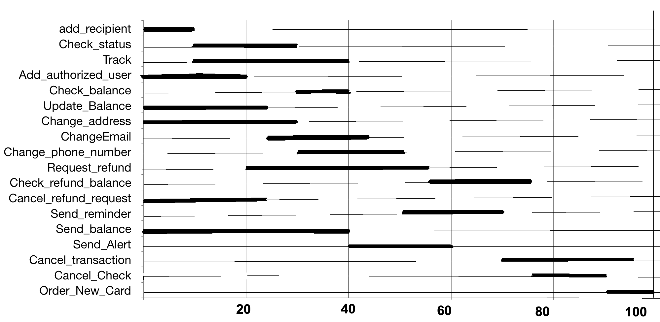
BAR CHART

Slide 43
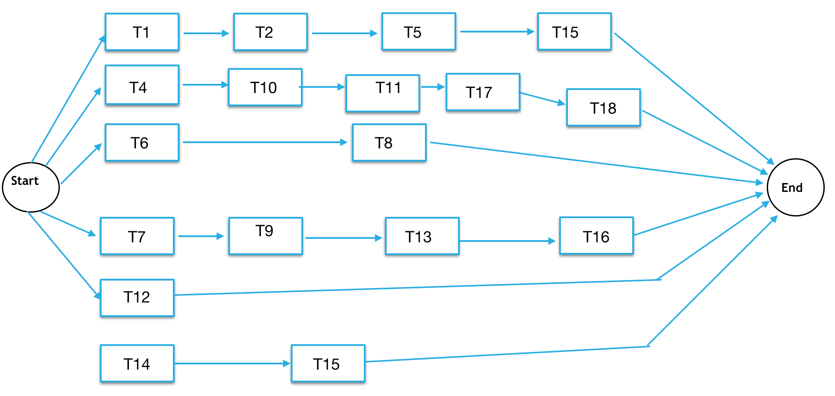
ACTIVITY CHART

Slide 44
12.Identify milestone,deliverables critical path
Critical path = t1 +t2 +t8 +t13+t16= 10+ 15+ 25+ 35+25 =110
Milestones:
Start up $30500
M1 $30500
M2 $30500
Delivery: 122,000
Milestone 1 Deliverable: code outline and Explanation T3 : $220 000
Milestone 2 Deliverable: Working prototype and demonstration T10 : $180 000
Milestone 3 Deliverable: Websie showcase T2 : $204 500
---------------------------------------------------------------
Total cost : $620 000

Slide 45
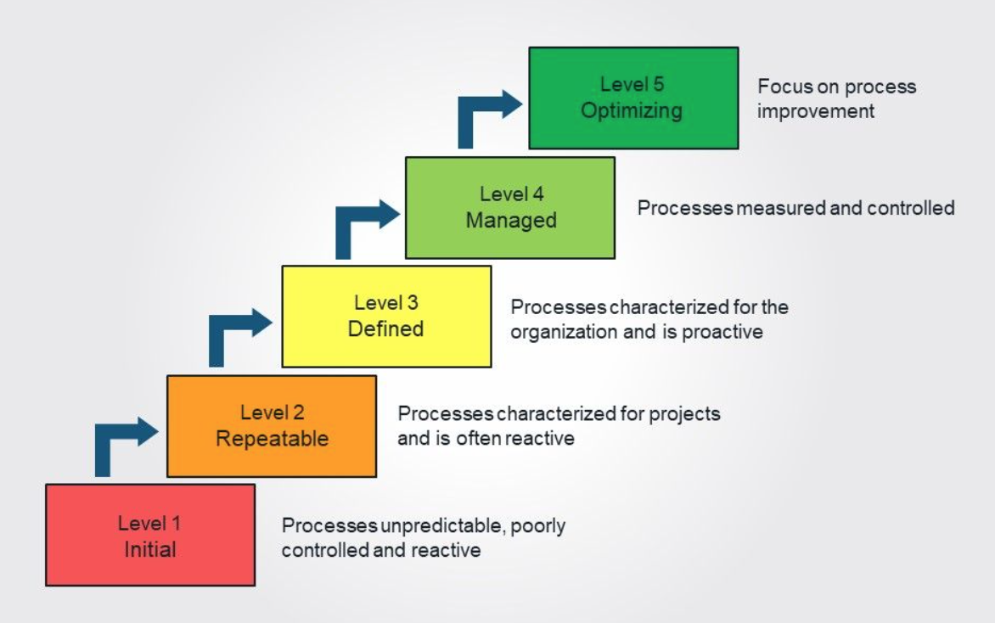
13.cmm (Capability maturity model)

Slide 46
The Capability Maturity Model or CMM will be in level 2. With all the testing that we have to do, the robot will consistently be in a stage where updates and repairs have to be made. With level 2 of the Capability Maturity Model, repetition is key for ensuring quality results.
The Software Engineering Institute (SEI) Capability Maturity Model (CMM) specifies an increasing series of levels of a software development organization. The higher the level, the better the software development process, hence reaching each level is an expensive and time-consuming process.

Slide 47
Level One :Initial - The software process is characterized as inconsistent, and occasionally even chaotic. Defined processes and standard practices that exist are abandoned during a crisis. Success of the organization majorly depends on an individual effort, talent, and heroics. The heroes eventually move on to other organizations taking their wealth of knowledge or lessons learnt with them.
Level Two: Repeatable - This level of Software Development Organization has a basic and consistent project management processes to track cost, schedule, and functionality. The process is in place to repeat the earlier successes on projects with similar applications. Program management is a key characteristic of a level two organization.
Level Three: Defined - The software process for both management and engineering activities are documented, standardized, and integrated into a standard software process for the entire organization and all projects across the organization use an approved, tailored version of the organization's standard software process for developing,testing and maintaining the application.
Level Four: Managed - Management can effectively control the software development effort using precise measurements. At this level, organization set a quantitative quality goal for both software process and software maintenance. At this maturity level, the performance of processes is controlled using statistical and other quantitative techniques, and is quantitatively predictable.
Level Five: Optimizing - The Key characteristic of this level is focusing on continually improving process performance through both incremental and innovative technological improvements. At this level, changes to the process are to improve the process performance and at the same time maintaining statistical probability to achieve the established quantitative process-improvement objectives.

Slide 48
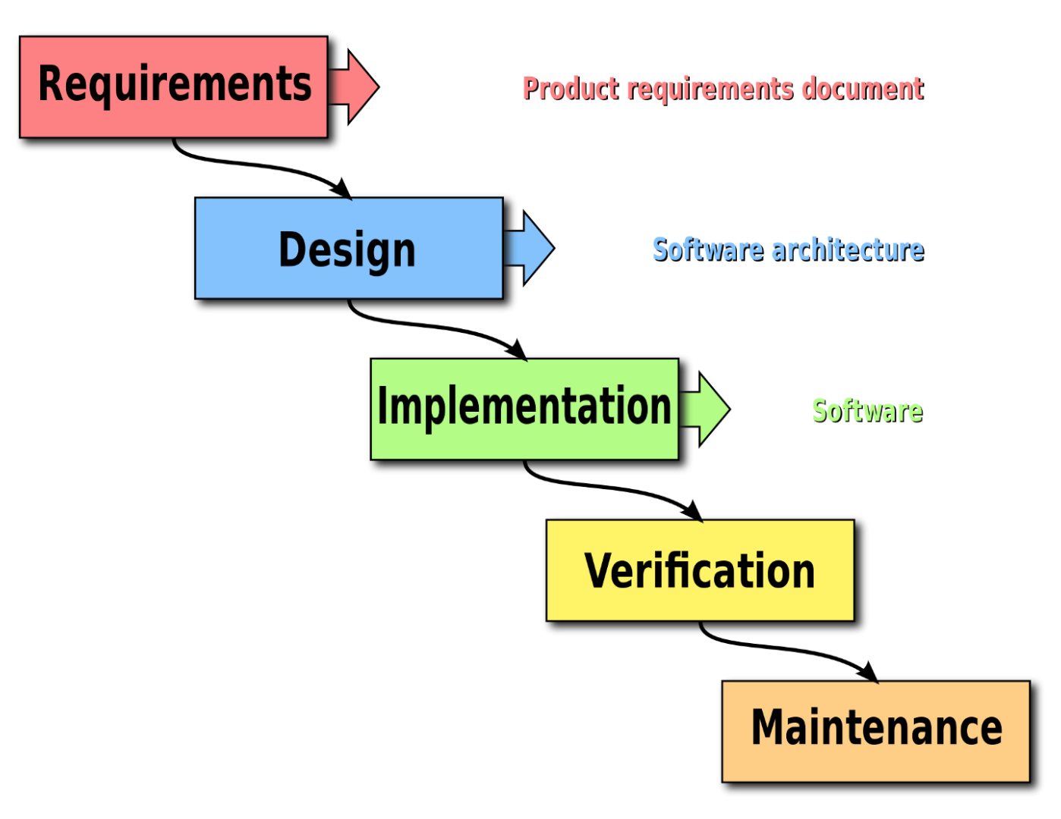
14.CASE TOOL

Slide 49
14.Case tool
Based on CMM a case tool is a standard term used to indicate any form of automated support for software engineering. In a more preventive sense, a CASE tool means any tool used to automate some activity associated with software development which includes Web Development, Mobile application Development, eCommerce web development etc.
Goal: to add Case tools to reduce time and cost of software development and enhance quality of the systems developed
Case tools for this project include: design editors, data dictionaries, compilers, debuggers and system building tools

Slide 50
15 & 16.Software Duration, cost estimate to develop,test integrate, and deliver
100000 lines of code
Project level 2
DSI =2 CMM = level 2 = $20 000

Slide 51
Product attributes:
Required Software reliability :1.6
Data base size 1.1
Product complexity 1.25

Slide 52
Computer attributes:
Execution time constraints 1.4
Main storage constraint 1.5
Virtual machine volatility 1.03
Computer turnaround time 1.09

Slide 53
Personal attributes:
Analyst capabilities .92
Application experience .87
Programmer capability .78
Virtual machine capability 1.12
Programming language experience .90

Slide 54
Project attributes:
Use of modern programming practices .92
Use of software tools .95
Required development schedule 1.55

Slide 55
Duration:
3.3*2^1.05=6.83
=6.83*(1.6)*(1.1)*(1.25)*(1.4)*(1.5)*(1.03)*(1.09)*(0.92)*(0.87)*(0.78)*(1.12)*(0.9)*(0.92)*(0.95)*(1.55)*=30.20
It will take 31 months to complete this project with all of the requirements.

Slide 56
Cost:
Cost estimate for the project
31 * 20 000 = $620 000

Slide 57
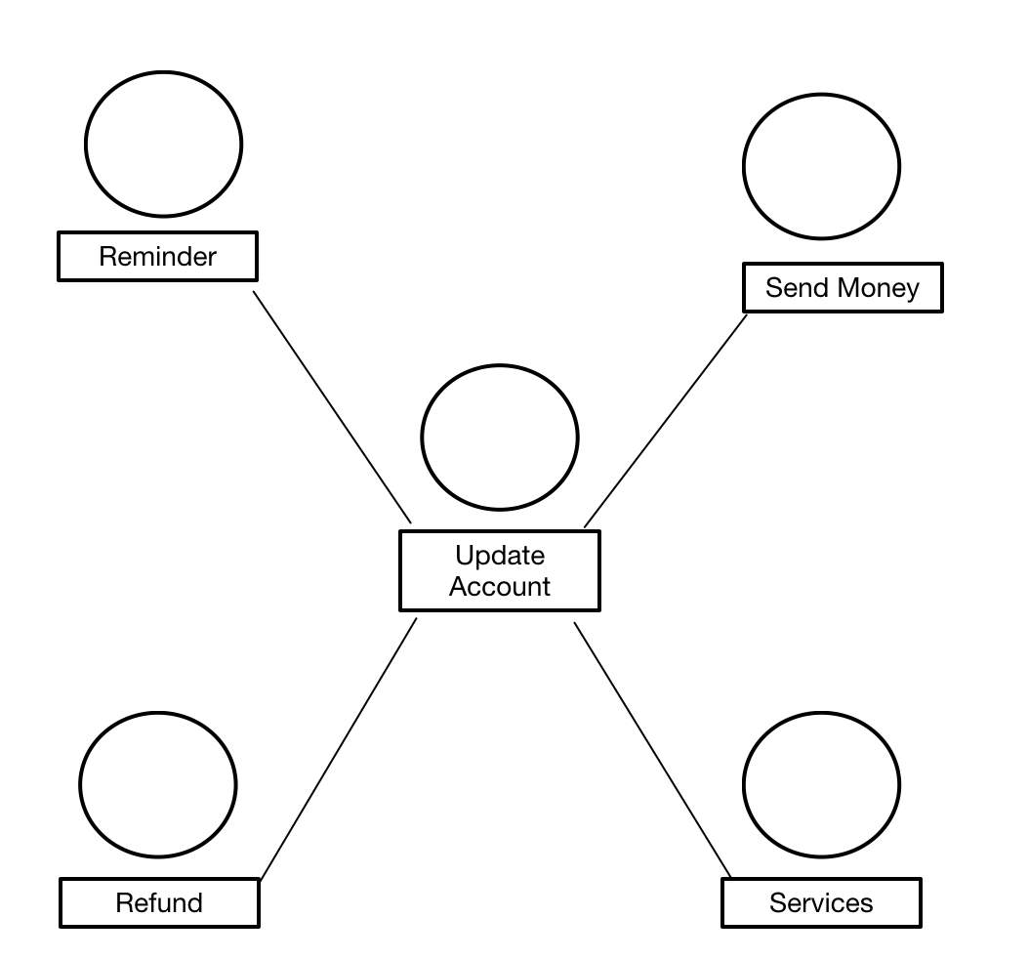
17. Overall class Diagram:

Slide 58
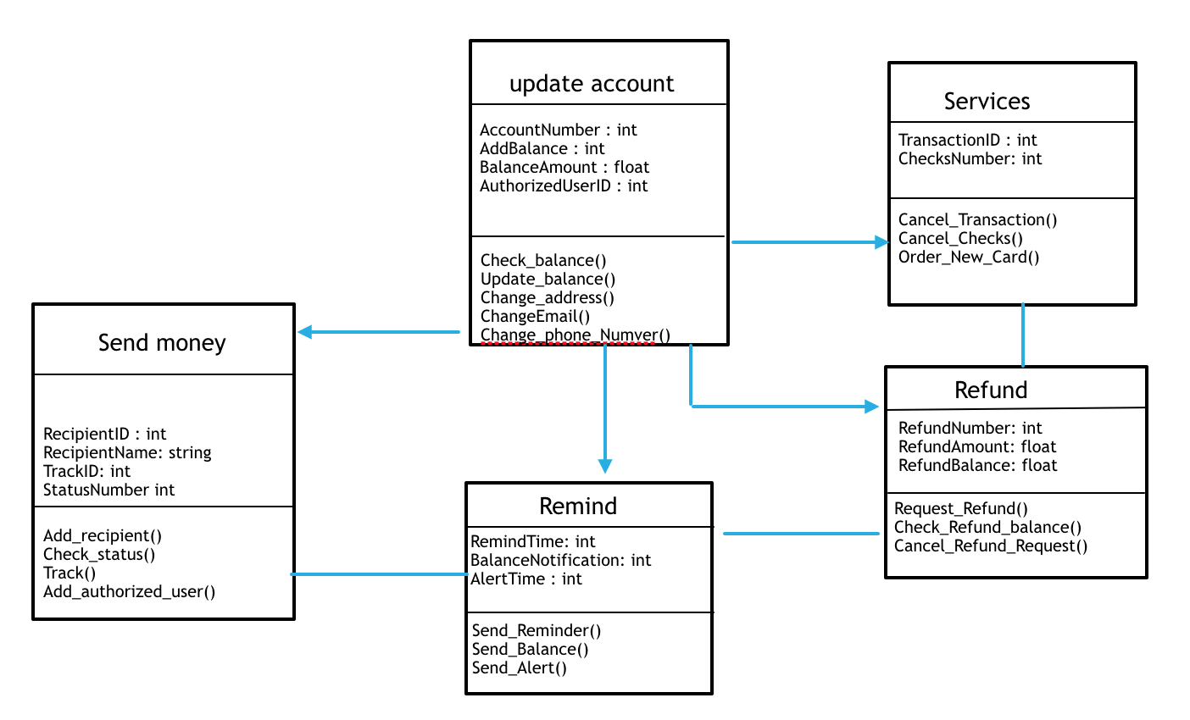
18.UML Diagram for all classes

Slide 59
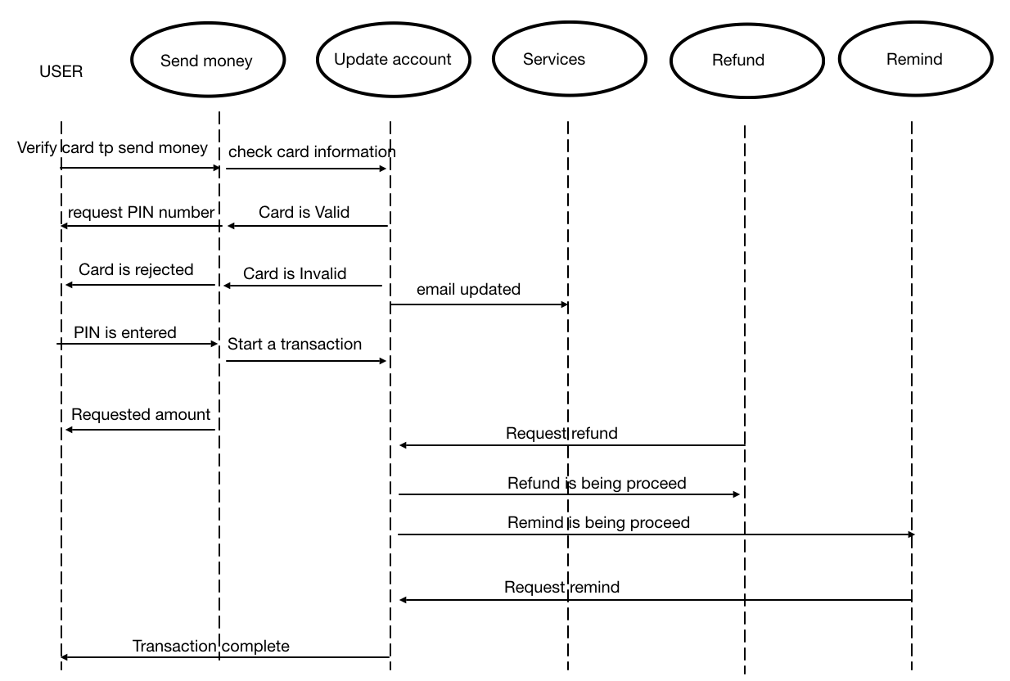
19.Overall Sequence Diagram

Slide 60
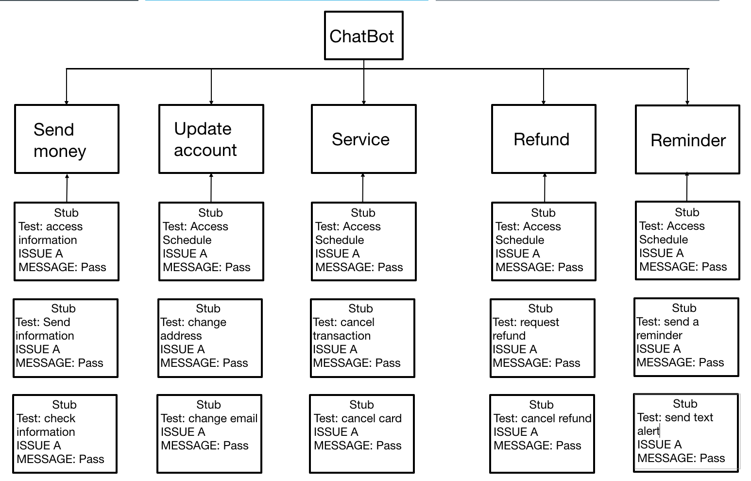
20.Sequence diagram

Slide 61
21.Test PLAN
A.System test:
U: call send money
S: error
U: fix the problem
U: call send money
S: accepted
U: call reminder ()
S: accepted
U: call update account
S: error
U: fix the problem
U: call update account
S: accepted

Slide 62
Select one average size class ( subsystem),test and prints messages.
B.Average size class:
U: call Change_address();
S: error
U: Fix the Problem
U: call Change_address();
S: accepted
U: call ChangeEmail();
S: accepted
U: call Change_phone_Number()
S:error
U: Fix the probelm
U: call Change_phone_Number()
S: accepted

Slide 63
Select one method(function), test and print messages
C. Function test
U: cout<<“Add deposit to the account balance”<<Deposit<<+<<AccountBalance<<endl;
S: error deposit is not declared
U: Fix the problem
U:<<cout” Add deposit to account balance”<<Deposit<<+<<Accountbalance<<endl;
S: Accepted

Slide 64
Select one unit test and print a message
D. Unit test: Function name
U: SetInterestRate()
S: error SetInterestRate is not declared
U: Fix the problem
U: SetInterestRate()
S: accepted

Slide 65
23. Maintenance plan,corrective,perfective, adaptive,Post-delvery maint.(inhouse/outsource)
IN-HOUSE DEVELOPMENT:
No language/cultural boundaries
Deep involvement
In-project expertise
Huge price.
Staff dismissal.
The lack of expertise in different areas.
OUTSOURCED SOFTWARE DEVELOPMENT:
Price-wise expertise.
Smart time-to-market.
Easy scaling of teams.
Streamlined processes.
Mutual understanding.
Transparency and security risks.
Risk of receiving the unsupported code.
I chose IN-HOUSE development because software maintenance is part of Software development life cycle, there is no need to look for other companies and spend more money to get stuff done .It’s main purpose is to modify and update the software application after delivery to correct faults and to improve performance. Software is a model of the real world. When the real world changes, the software requires modification wherever possible.

Slide 66
Catergories of software maintenance:
1. corrective maintenance: may be essential to either rectify some bugs observed while the system is in use or to enhance the performance of the system
2. Perfective maintenance: a software product needs maintenance to support the new features that the users want or to change different types of functionalities of the system according to the customer demands
3. Adaptive maintenance: This includes modifications and updates when the customers need the product to run on new platforms, on new operating systems, or when they need the product to interface with new hardware or software
4. Preventive maintenance: This type of maintenance includes modifications and updates to prevent future problems in software. It’s goal is to attend to problems which are not significant in the moment but may cause serious issues in the future.

Slide 67
Post delivery maintenance
After the software is developed and deployed into production keeping it running to the user’s expectations requires maintaining it.
This software maintenance isn’t just fixing the bugs discovered by users after it is delivered, but it involves activities like establishing desk top to support the users, training, documentation, and enhancements.
I chose the in house maintenance plan for my project because changes must be made as soon as possible with Chatbot

Slide 68
24.Codes changed
1. Class name: operator interface {}
2. I chose to add another case
3. line 16 I added another string called “Maintain Report”
line 33 add case 4
line 34 add function new Maintain Report ()
1. Class name: Print_Invoice_ Report {}
I changed year from 1900 to 2020
Line 61 : Interger.toString(date.getyear()+2020)
1. Class name : Maintain-service_Request{}
2. I changed time from 1.9 to 2.1
3. In line 48
WorstCasePenalty = if( std >2.1 && std 23.1)
Notes:
Il

Slide 69
25. Verification and Validation:
Verification :
meets system specification:
It must have the correct algorithm.
It must have functions.
It has to meet the project’s specifications
The size has to be expandable
Validation :
The system must meet the client’s needs at delivery:
It has to answer all the questions asked by the customer.
All function must be working properly.

Slide 70
26 – Decommission preparation plan:
Post-Delivery: includes all changes after acceptance testing to remove bugs to improve performance modify documentation but software engineering about maintenance Finding & fixing.
Analysis: Analysis would involve doing consistent checks towards the systems to ensure any adjustments would be either beneficial and or completely necessary in terms of operation.
Design: The design will remain consistent based off the system already implemented as the final product.

Slide 71
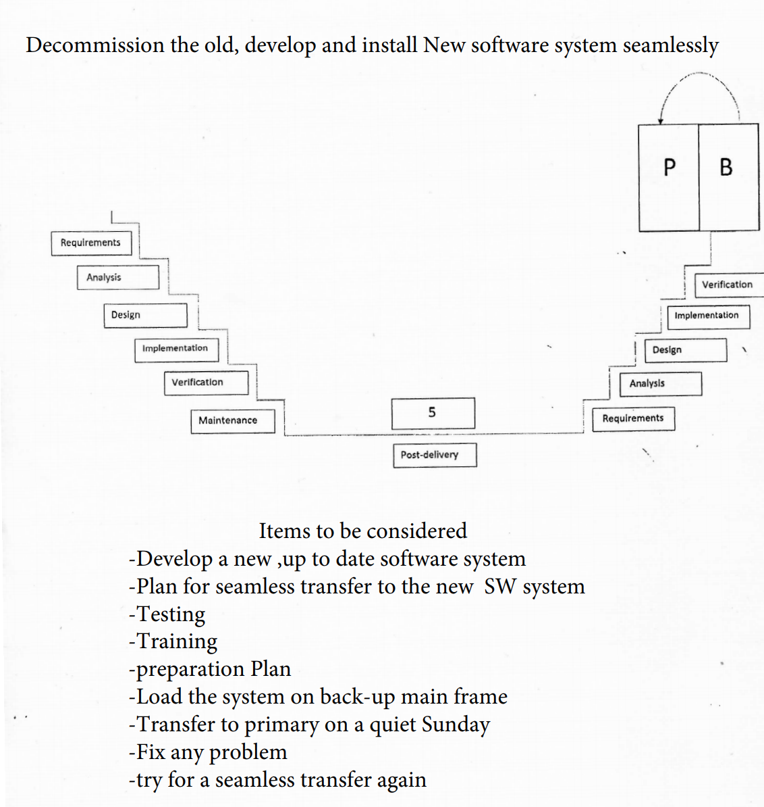

Slide 72
27. Hardware, FF,MUX,BUS,ALU,CU,CPU,Control Memory,state diag,
2.6 ghz 6-core 9 generation intelcore i7 processor
Turbo boost up to 4.5 ghz
AMD Radeon Pro5300M with 4G of GDDR6 memory
16 GB 1of 2666 MHz DDR4 memory
512 GB of SSD storage

Slide 73
27.HARDWARE, FF,MUX,BUS,ALU,CU,CPU,CONTROL MEMORY,STATE DIAGram:
Hardware: tools, machinery, and other durable equipment
FF: is a circuit that has two stable states and can be used to store state information
MUX: is a device allowing one or more low speed analog or digital input signals to be selected, combined and transmitted at a higher speed on a single shared medium, or within a single shared device.
BUS: is a communication system that transfers data between components inside a computer, or between computers. This expressions covers all related hardware components and software, and communication protocols
ALU: an arithmic logic unit is a combinatinal digital circuit that performs arthimatic and bitwise operations on interger binary numbers
Cu: contains circritry that uses electrical signals to direct the entire computer system to carry out or execute, stored program instructions
Cpu: processes all instructions received by software running on the PC and by other hardware components, and acts as a powerful calculator
Control memory: is random access memory consisting of addressable storage registers. It is primarily used in mini and mainframe computers. It is used as temporary storage for data.
State diagram: a type of diagram used in computer science and related fields to describe the behavior of systems.

Slide 74
28.Massive parallelism, Neural network, systolic arrays,quantum computing
Massive parallelism: a form of processing of the same program by multiple processors collaboratively where different threads of the program are handled by each processor. Each processor has its own operating system and memory.
Neural network: a series of algorhithms that endeavors to recognize underlying relationships in a set of data through a process that mimics the way the human brain operates. The neural network refers to the system of neurons either organic or artificial in nature.
Systolic array: a network of processors that pass data through the system
Quantom computing: an area of computing focused on developing computer technology based on the principles of quantum theory. Quantum theory explains the behavior of energy and material on the atomic and subatomic levels.

Slide 75
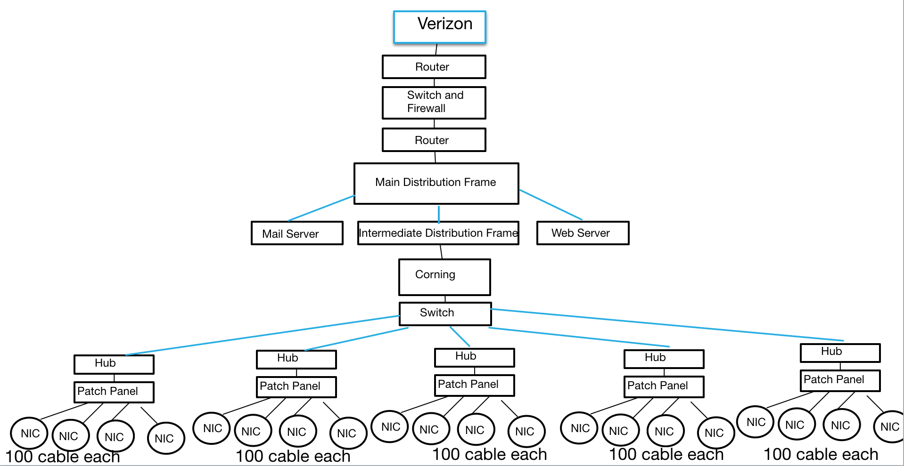

Slide 76
29.Telecomm.2000pc1,Hub,switch,corning,router,gateway,fireWall,1G-5G…
Telecom: is the exchange of information over significant distances by electronic means, referring to all types of voice, data and video transmission. Hub: a hub is the most basic networking device that connects multiple computers or other network devices together.
Switch: a switch is used to network multiple computers together. Switches made for the consumer market are typically small, flat boxes with 4 to 8 Ethernet ports.
Corning: Corning is one of the world's leading innovators in materials science. Corning has applied its unparalleled expertise in speciality glass, ceramics, and optical physics to develop products that have created new industries and transformed people's lives.
Router: a router is a networking device that forwards data packets between computer networks. Routers perform the traffic directing functions on the Internet. Data sent through the internet, such as a web page or email, is in the form of data packets.
Gateway: a gateway is a piece of networking hardware used in telecommunications for telecommunications networks that allows data to flow from one discrete network to another. A gateway is a network node used in telecommunications that connects two networks with different transmission protocols together. Gateways serve as an entry and exit point for a network as all data must pass through or communicate with the gateway prior to being
Firewall: a firewall is a network security device that monitors incoming and outgoing network traffic and decides whether to allow or block specific traffic based on a defined set of security rules.
15-5g: 5G is the 5th generation mobile network. It is a new global wireless standard after 1G, 2G, 3G, and 4G networks. 5G enables a new kind of network that is designed to connect virtually everyone and everything together including machines, objects, and devices.

Slide 77
30.SECURITY, PRIVACY AND DIGITAL FORENSICS IN THE CLOUD,
Internet security:
Internet security is a specific aspect of broader concepts such as cybersecurity and computer security, being focused on the specific threats and vulnerabilities of online access and use of the internet. In today's digital landscape, many of our daily activities rely on the internet.
Cyber Security:
cybersecurity or information technology security is the protection of computer systems and networks from the theft of or damage to their hardware, software, or electronic data, as well as from the disruption or misdirection of the services they provide.
Cyber Attacks:
A cyber attack is an assault launched by cybercriminals using one or more computers against a single or multiple computers or networks. A cyber attack can maliciously disable computers, steal data, or use a breached computer as a launch point for other attacks.
Cyber defense:
Cyber defense covers a wide range of activities that are essential in enabling your business to protect itself against attack and respond to a rapidly evolving threat landscape. This will include: Cyber deterrents to reduce your appeal to the attackers. Preventative controls that require their attacks to be more costly.

Slide 78
Security in the Cloud:
Cloud security is the protection of data stored online via cloud computing platforms from theft, leakage, and deletion. Methods of providing cloud security include firewalls, penetration testing, obfuscation, tokenization, virtual private networks, and avoiding public internet connections.
Cloud computing security or, more simply, cloud security refers to a broad set of policies, technologies, applications, and controls utilized to protect virtualized IP, data, applications, services, and the associated infrastructure of cloud computing.
Privacy in the Cloud :
Privacy is the ability of an individual or group to seclude themselves or information about themselves and thereby reveal them selectively [43]. Privacy has the following elements.
When: a subject may be more concerned about the current or future information being revealed than information from the past.
How: a user may be comfortable if his/her friends can manually request his/her information, but the user may not like alerts to be sent automatically and frequently.
Extent: a user may rather have his/her information reported as an ambiguous region rather than a precise point.
Every individual has the right to control his or her own data, whether private, public or professional. Without knowledge of the physical location of the server or of how the processing of personal data is configured, end-users consume cloud services without any information about the processes involved.
Digital Forensics in the cloud :
NIST defines digital forensics as an applied science for “the identification, collection, examination, and analysis of data while preserving the integrity of the information and maintaining a strict chain of custody for the data.

Slide 79
31.Programming language:
Python: is often used as a supportive language for software developers, for build control and management, testing, and in many other ways. Scons for build control.
ActionScript is an object-oriented programming language originally developed by Macromedia Inc. It is influenced by HyperTalk, the scripting language for HyperCard.
Ada is a structured, statically typed, imperative, and object-oriented high-level programming language, extended from Pascal and other languages.
Assembly :is any low-level programming language in which there is a very strong correspondence between the instructions in the language and the architecture's machine code instructions.
C is a general-purpose, procedural computer programming language supporting structured programming, lexical variable scope, and recursion, with a static type system.
C# is a general-purpose, multi-paradigm programming language encompassing static typing, strong typing, lexically scoped, imperative, declarative, functional, generic, object-oriented, and component-oriented programming disciplines
C++ is a general-purpose programming language created by Bjarne Stroustrup as an extension of the C programming language, or "C with Classes".
COBOL is a compiled English-like computer programming language designed for business use. It is imperative, procedural and, since 2002, object-oriented. COBOL is primarily used in business, finance, and administrative systems for companies and governments.
ColdFusion Markup Language, more commonly known as CFML, is a scripting language for web development that runs on the JVM, the .NET framework, and Google App Engine.
D: is a multi-paradigm system programming language created by Walter Bright at Digital Mars and released in 2001. Andrei Alexandrescu joined the design and development effort in 2007. Though it originated as a re-engineering of C++, D is a distinct language.
Delphi is a software product that uses the Object Pascal programming language and provides an integrated development environment for rapid application development of desktop, mobile, web, and console software, currently developed and maintained by Embarcadero Technologies.
Erlang is a general-purpose, concurrent, functional programming language, and a garbage-collected runtime system.
Forth is an imperative stack-based computer programming language and environment originally designed by Chuck Moore. Language features include structured programming, reflection, concatenative programming and extensibility.
Haskell is a general-purpose, statically typed, purely functional programming language with type inference and lazy evaluation.
Java is a class-based, object-oriented programming language that is designed to have as few implementation dependencies as possible.
Javascripy :is a programming language that conforms to the ECMAScript specification. JavaScript is high-level, often just-in-time compiled, and multi-paradigm.
Lisp is a family of programming languages with a long history and a distinctive, fully parenthesized prefix notation. Originally specified in 1958, Lisp is the second-oldest high-level programming language in widespread use today. Only Fortran is older, by one year.
Lua is a lightweight, high-level, multi-paradigm programming language designed primarily for embedded use in applications. Lua is cross-platform, since the interpreter of compiled bytecode is written in ANSI C, and Lua has a relatively simple C API to embed it into applications.
Objective-C is a general-purpose, object-oriented programming language that adds Smalltalk-style messaging to the C programming language.
OCaml is a general-purpose, multi-paradigm programming language which extends the Caml dialect of ML with object-oriented features.

Slide 80
PHP is a general-purpose scripting language especially suited to web development.
Pascal is an imperative and procedural programming language, designed by Niklaus Wirth as a small, efficient language intended to encourage good programming practices using structured programming and data structuring.
Perl is a family of two high-level, general-purpose, interpreted, dynamic programming languages.
Python is an interpreted, high-level and general-purpose programming language.
Rexx is an interpreted programming language developed at IBM by Mike Cowlishaw. It is a structured, high-level programming language designed for ease of learning and reading.
Ruby is an interpreted, high-level, general-purpose programming language.
Scala is a general-purpose programming language providing support for both object-oriented programming and functional programming.
SQL is a domain-specific language used in programming and designed for managing data held in a relational database management system, or for stream processing in a relational data stream management system.
Scheme is a minimalist dialect of the Lisp family of programming languages. Scheme consists of a small standard core with powerful tools for language extension.
A shell script is a computer program designed to be run by the Unix shell, a command-line interpreter.
Smalltalk is an object-oriented, dynamically typed reflective programming language.
Tcl is a high-level, general-purpose, interpreted, dynamic programming language. It was designed with the goal of being very simple but powerful..
Visual Basic is a third-generation event-driven programming language from Microsoft known for its Component Object Model programming model .

Slide 81
32.Algorithm and statistics used in the project.
Algorithms
For each kind of question, a unique pattern must be available in the database to provide a suitable response. With lots of combination on patterns, it creates a hierarchical structure. We use algorithms to reduce the classifiers and generate the more manageable structure. Computer scientists call it a “Reductionist” approach- in order to give a simplified solution, it reduces the problem.
Multinational Naive Bayes is the classic algorithm for text classification and NLP. For an instance, let’s assume a set of sentences are given which are belonging to a particular class. With new input sentence, each word is counted for its occurrence and is accounted for its commonality and each class is assigned a score. The highest scored class is the most likely to be associated with the input sentence.
For example Sample Training set
class: greeting
“How you doing?”
“good morning”
“hi there”
Few sample Input sentence classification:
input: “Hello good morning”
term: “hello” (no matches)
Term: “good” (class: greeting) term: “morning” (class: greeting)
classification: greeting (score=2)
With the help of equation, word matches are found for given some sample sentences for each class. Classification score identifies the class with the highest term matches but it also has some limitations. The score signifies which intent is most likely to the sentence but does not guarantee it is the perfect match. Highest score only provides the relativity base.

Slide 82
Sample training set
Class: greeting
“How are you doing?”
“good morning”
“hi there”

Slide 83
33.Activity log of changes, decisions, modifications and dates
who | what | When | Status
client | Chatbot requirements and functionalities | 9/1/2020 | accept
Project manager | Requirements and feasibility analysis | 9/10/2020 | accept
Development team | Brainstorm and planning | 9/18/2020 | reject
Team manager | Planning and designing | 9/29/2020 | accept
Project manager | Development and coding | 10/10/2020 | accept
Development team | Update planning | 10/19/2020 | reject

Slide 84
Activity log of changes cont.
Project manager | Checking if all requirements have been met | 10/24/2020 | accept
Development team/project manager | Testing the chatbot and making sure all functions work properly | 10/28/2020 | Accept
Project manager | Presenting the project to the client | 11/07/2020 | accept

